Slide 1

Introduction to Relational Model
Unit-2
Sources: Reference Book, NPTEL website, Internet

Slide 2

Looping
Outline
Structure of Relational Databases
Database Schema
Keys
Schema Diagrams
Relational Query Languages
The Relational Algebra

Slide 3
Structure of Relational Databases
Columns (5)
Table (Relation): A database object that holds a collection of data for a specific topic.
Table consist of rows and columns.
Student
Attributes:
Title of column
RollNo | Name | Branch | Semester | SPI
101 | Raju | CE | 3 | 8
102 | Mitesh | CI | 3 | 7
103 | Mayur | CE | 3 | 6
104 | Nilesh | EE | 3 | 9
105 | Hitesh | CI | 3 | 7
106 | Tarun | ME | 3 | 8
107 | Suresh | CE | 3 | 9
Column (Attribute): The vertical component of a table. A column has a name and a particular data type; e.g. varchar, decimal, integer, datetime etc.
Rows or
Tuples or Records (7)
Record (Tuple): The horizontal component of a table, consisting of a sequence of values, one for each column of the table. It is also known as row.
Cardinality = No of tuples (7)
A database consists of a collection of tables (relations), each having a unique name.
Degree = No of columns (5)
Domain is a set of all possible unique values for a specific column.
Domain of Branch attribute is (CE, CI, ME, EE)

Slide 4
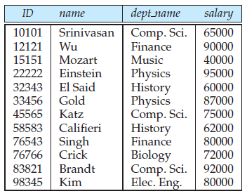
Relation Schema and Instance
A₁, A₂, …, A_{n} are attributes
R = (A₁, A₂, …, A_{n} ) is a relation schema
Example:
instructor = (ID, name, dept_name, salary)
A relation instance r defined over schema R is denoted by r (R).
The current values a relation are specified by a table
An element t of relation r is called a tuple and is represented by a row
in a table
Relation=table
Tuple=row
Attribute=column

Slide 5
Attributes
The set of allowed values for each attribute is called the domain of the attribute
Attribute values are (normally) required to be atomic; that is, indivisible
The special value null is a member of every domain. Indicated that the value is “unknown” or does not exist
The null value causes complications in the definition of many operations
For example: consider a relation student(rollno, name, phone) and for a particular tuple(row) student does not carry phone.
We shall see later that null values cause a number of difficulties when we access or update the database.
Relations are Unordered
Order of tuples is irrelevant (tuples may be stored in an arbitrary order)
Example: instructor relation with unordered tuples

Slide 6
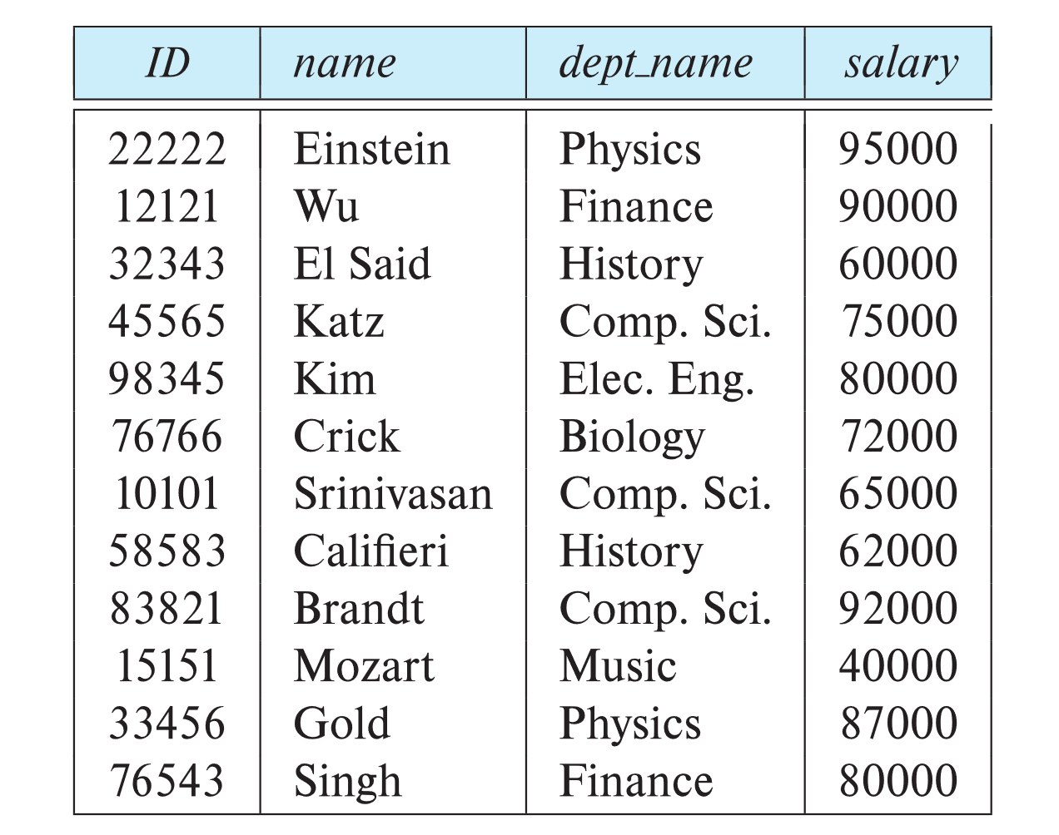
Database Schema
Database schema -- is the logical structure of the database.
Database instance -- is a snapshot of the data in the database at a given instant in time.
Example:
schema: instructor (ID, name, dept_name, salary)
Instance
Relational Database schema(related relations)
• student (ID, name, dept name, tot cred)
• advisor (s id, i id)
• takes (ID, course id, sec id, semester, year, grade)
• classroom (building, room number, capacity)
• time slot (time slot id, day, start time, end time)

Slide 7
Keys
We must have a way to specify how tuples within a given relation are distinguished i.e. attribute values of a tuple must be such that they can uniquely identify the tuple{no redundancy}
Different Types of Keys
Super Key
Candidate Key
Primary Key
Alternate Key
Foreign Key

Slide 8
Let K ⊆ R
K is a superkey of R if values for K are sufficient to identify a unique tuple of each possible relation r(R) {set of one or more attributes that, taken collectively, allow us to identify uniquely a tuple in the relation}
Example: {ID} and {ID,name} are both superkeys of instructor.
Superkey K is a candidate key if K is minimal
Example: {ID} is a candidate key for Instructor
One of the candidate keys is selected to be the primary key.
which one?
Foreign key constraint: Value in one relation must appear in another
Referencing relation
Referenced relation
Example: dept_name in instructor is a foreign key from instructor referencing department

Slide 9
Super Key
A super key is a set of one or more attributes whose values uniquely identifies each record within a relation (table).
Super Key
EnrollNo
Super Key
(RollNo, Branch, Sem)
Super Key
(SPI, Name, BL)
EnrollNo | RollNo | Branch | Sem | SPI | Name | BL
190540107001 | 101 | CE | 3 | 8 | Raju | 0
190540107002 | 102 | CE | 3 | 7 | Mitesh | 1
190540106001 | 101 | CI | 3 | 6 | Mayur | 2
190540106002 | 102 | CI | 3 | 9 | Nilesh | 0
180540107001 | 101 | CE | 5 | 7 | Hitesh | 1
180540106001 | 101 | CI | 5 | 8 | Tarun | 0
180540106002 | 102 | CI | 5 | 9 | Suresh | 0
Adding zero or more attributes to candidate key generates super key.

Slide 10
Candidate Key
A candidate key is a subset of a super key.
The minimal set of attribute which can uniquely identify a tuple is known as candidate key. E.g. EnrollNo
The value of Candidate Key is unique and non-null for every tuple.
There can be more than one candidate key in a relation
Every candidate key is a super key but every super key is not a candidate key.
The candidate key can be simple (having only one attribute) or composite as well
Candidate Key
EnrollNo
Candidate Key
(RollNo, Branch, Sem)
EnrollNo | RollNo | Branch | Sem | SPI | Name | BL
190540107001 | 101 | CE | 3 | 8 | Raju | 0
180540107002 | 101 | CE | 5 | 7 | Mitesh | 1
190540106001 | 101 | CI | 3 | 6 | Mayur | 2
180540106002 | 101 | CI | 5 | 9 | Nilesh | 0

Slide 11

Primary Key
A primary key is a candidate key that is chosen by database designer to identify tuples uniquely in a relation (table).
Primary Key
Candidate Key
EnrollNo
Candidate Key
(RollNo, Branch, Sem)
EnrollNo | RollNo | Branch | Sem | SPI | Name | BL
190540107001 | 101 | CE | 3 | 8 | Raju | 0
180540107002 | 101 | CE | 5 | 7 | Mitesh | 1
190540106001 | 101 | CI | 3 | 6 | Mayur | 2
180540106002 | 101 | CI | 5 | 9 | Nilesh | 0

Slide 12
Alternate Key
The candidate key other than the primary key is called an alternate key.
An alternate key is a candidate key that is not chosen by database designer to identify tuples uniquely in a relation.
Primary Key
Alternate Key
Candidate Key
EnrollNo
Candidate Key
(RollNo, Branch, Sem)
EnrollNo | RollNo | Branch | Sem | SPI | Name | BL
190540107001 | 101 | CE | 3 | 8 | Raju | 0
180540107002 | 101 | CE | 5 | 7 | Mitesh | 1
190540106001 | 101 | CI | 3 | 6 | Mayur | 2
180540106002 | 101 | CI | 5 | 9 | Nilesh | 0

Slide 13
Primary Key rules
A primary key may have one or more attributes.
There is only one primary key in the relation (table).
A primary key attribute value cannot be NULL.
Generally, the value of a primary key attribute does not change.

Slide 14
Foreign Key
A foreign key is used to link two relations (tables).
A foreign key is an attribute or collection of attributes in one table that refers to the primary key in another table.
A table containing the foreign key is called the child table, and the table containing the primary key is called the parent table.
Parent
Table
Child
Table
Student
Project
EnrollNo | Name | Branch | Sem
190540107001 | Raju | CE | 3
190540107002 | Mitesh | CE | 3
190540107003 | Nilesh | CE | 3
190540107004 | Meet | CE | 3
ProjectID | Title | EnrollNo
101 | Bank | 190540107001
102 | College | 190540107002
103 | School | 190540107003
104 | Hospital | 190540107001

Slide 15
Foreign Key: If an attribute can only take the values which are present as values of some other attribute.
The relation which is being referenced is called referenced relation and the corresponding attribute is called referenced attribute and the relation which refers to the referenced relation is called referencing relation and the corresponding attribute is called referencing attribute.
The referenced attribute of the referenced relation should be the primary key for it. For Example, EnrollNO in Project is a foreign key of the relation.
It may be worth noting that unlike, Primary Key of any given relation, Foreign Key can be NULL as well as may contain duplicate tuples i.e. it need not follow uniqueness constraint.
For Example, EnrollNO in Project relation is not unique. It has been repeated for the first and fourth tuple. However, the EnrollNO in Student relation is a primary key and it needs to be always unique and it cannot be null.

Slide 16
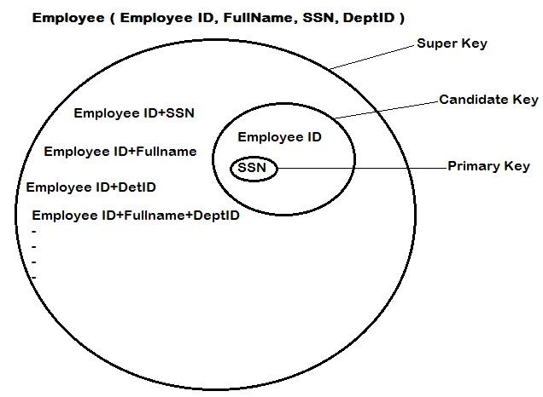
Candidate Key: are individual columns in a table that qualifies for uniqueness of all the rows. Here in Employee table EmployeeID & SSN are Candidate keys.
Primary Key: is the columns you choose to maintain uniqueness in a table. Here in Employee table you can choose either EmployeeID or SSN columns.
Super Key: If you add any other column/attribute to a Primary Key(candidate key) then it become a super key, like EmployeeID + FullName is a Super Key.
Alternate Key: Candidate column other the Primary column, like if SSN is PK then EmployeeID would be the Alternate key.

Slide 17
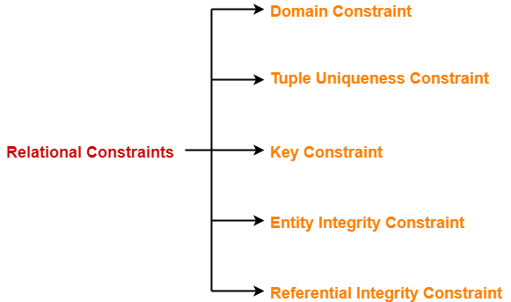
Constraints
Relational constraints are the restrictions imposed on the database contents and operations.
They ensure the correctness of data in the database.

Slide 18
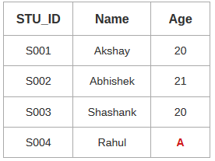
1. Domain Constraint-
Domain constraint defines the domain or set of values for an attribute.
It specifies that the value taken by the attribute must be the atomic value from its domain
Consider the following Student table-
Here, value ‘A’ is not allowed since only integer values can be taken by the age attribute.

Slide 19
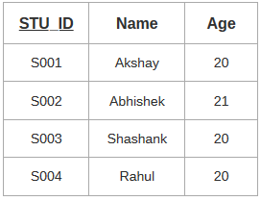
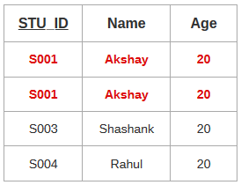
2. Tuple Uniqueness Constraint-
Tuple Uniqueness constraint specifies that all the tuples must be necessarily unique in any relation.
Consider the following table.
This relation satisfies the tuple uniqueness constraint since here all the tuples are unique.
The second relation does not satisfy the tuple uniqueness constraint since here all the tuples are not unique.

Slide 20
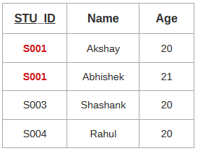
3. Key Constraint-
Key constraint specifies that in any relation-
All the values of key must be unique.
Consider the table
This relation does not satisfy the key constraint as here all the values of primary key are not unique.

Slide 21
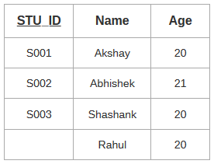
4. Entity Integrity Constraint-
Entity integrity constraint ensures that the primary key attribute in a relation, should not accept a null value.
This is because the presence of null value in the primary key violates the uniqueness property.
Consider the table
This relation does not satisfy the entity integrity constraint as here the primary key contains a NULL value.

Slide 22
5. Referential Integrity Constraint-
This constraint is enforced when a foreign key references the primary key of a relation.
It specifies that all the values taken by the foreign key must either be available in the relation of the primary key or be null.
The following two important results emerges out due to referential integrity constraint-
We can not insert a record into a referencing relation if the corresponding record does not exist in the referenced relation.
We can not delete or update a record of the referenced relation if the corresponding record exists in the referencing relation.

Slide 23
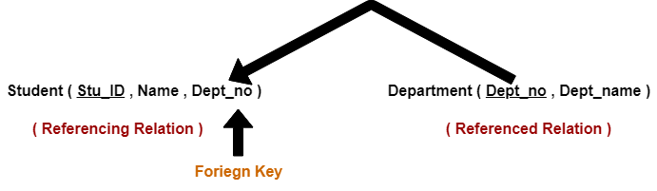
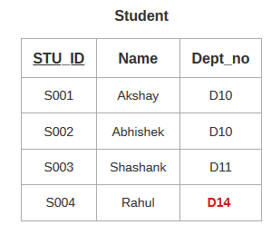
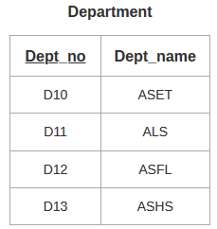
Here,
The relation ‘Student’ does not satisfy the referential integrity constraint.
This is because in relation ‘Department’, no value of primary key specifies department no. D14.
Thus, referential integrity constraint is violated.

Slide 24
RIC violation
RIC violation can occur on deletion or modification of a referenced tuple. On insertion there would be no violation. The Action to this can be specified for every case by using the qualifiers ON DELETE and ON UPDATE.
Actions to be taken are explained as follows :
After any violation to Referential Integrity Constraint has occurred, there can be three possibilities which can be used as an action : SET NULL, SET DEFAULT, CASCADE.
1. Referenced Relation : Table consists of Primary Key which is referenced by some foreign key. Actions :
a. DELETION :
ON DELETE NO ACTION : If referential integrity violation has occurred, the deletion would not be allowed.
ON DELETE CASCADE : In the case of referential integrity violation, the tuple would be deleted from both the relation i.e. Referenced as well as Referencing Relation. Whenever Primary Key is deleted, the corresponding tuple in the referencing relation is also deleted.
ON DELETE SET NULL : In the case of violation, then the values of FOREIGN KEY are set to NULL. If the FOREIGN KEY is a NOT NULL attribute , then ON DELETE SET NULL = ON DELETE NO ACTION.

Slide 25
b. UPDATION :
ON UPDATE NO ACTION : Updation would be restricted
ON UPDATE CASCADE : Updation would be performed in both the referenced as well as referencing relation.
ON UPDATE SET NULL : Referencing attribute tried to set NULL, if its a success , updation of referenced relation is allowed.
2. Referencing Relation :
INSERTION : Violation might occur. If the violation occurs, then insertion gets restricted.
DELETION : No violation occurs.
UPDATION : Referencing attribute may cause violation, in that case updation is not allowed.

Slide 26
SQL constraints
Not null
Create table emp(eid number(2) not null, ename varchar(10))
Unique
Create table emp(eid number(2) unique, ename varchar(10))
Primary key{unique-null}
Create table emp(eid number(2) primary key, ename varchar(10))
Foreign key
Create table person(pid int primary key, name varchar(10))
Create table order(oid int primary key, orderno int, pid int references person(pid))
Check
Create table person(pid int check(pid>0), name varchar(10))
Default
Create table emp(eid number(2), ename varchar(10),comm int default 0)

Slide 27
Relational Query Languages
Relational query languages use relational algebra to break the user requests and instruct the DBMS to execute the requests. It is the language by which user communicates with the database. These relational query languages can be procedural or non-procedural.
SQL has its own querying methods to interact with database. But how these queries work in the database? These queries work similar to relational algebra that we have in mathematics. In database we have tables participating in relational algebra.
Procedural Query Language
A procedural query language will have set of queries instructing the DBMS to perform various transactions in the sequence to meet the user request. For example, get_CGPA procedure will have various queries to get the marks of student in each subject, calculate the total marks, and then decide the CGPA based on his total marks. This procedural query language tells the database what is required from the database and how to get them from the database. Relational algebra is a procedural query language.
Non-Procedural Query Language
Non-procedural queries will have single query on one or more tables to get result from the database. For example, get the name and address of the student with particular ID will have single query on STUDENT table. Relational Calculus is a non procedural language which informs what to do with the tables, but doesn’t inform how to accomplish this.

Slide 28
Relational Algebra
Relational algebra is a procedural query language. It takes one or more relations / tables and performs the operation and produce the result. This result is also considered as a new table or relation.
Relational algebra will have operators to indicate the operations. This algebra can be applied on single relation – called unary or can be applied on two tables – called binary.
Relational Algebra works on the whole table at once, so we do not have to use loops etc to iterate over all the rows(tuples) of data one by one.
Relational Algebra is formal description of how relational database operates.
It is a procedural query language, i.e. user must define both “how” and “what” to retrieve.
All we have to do is specify the relation(table) name from which we need the data, and in a single line of command, relational algebra will traverse the entire given table to fetch data for you.

Slide 29
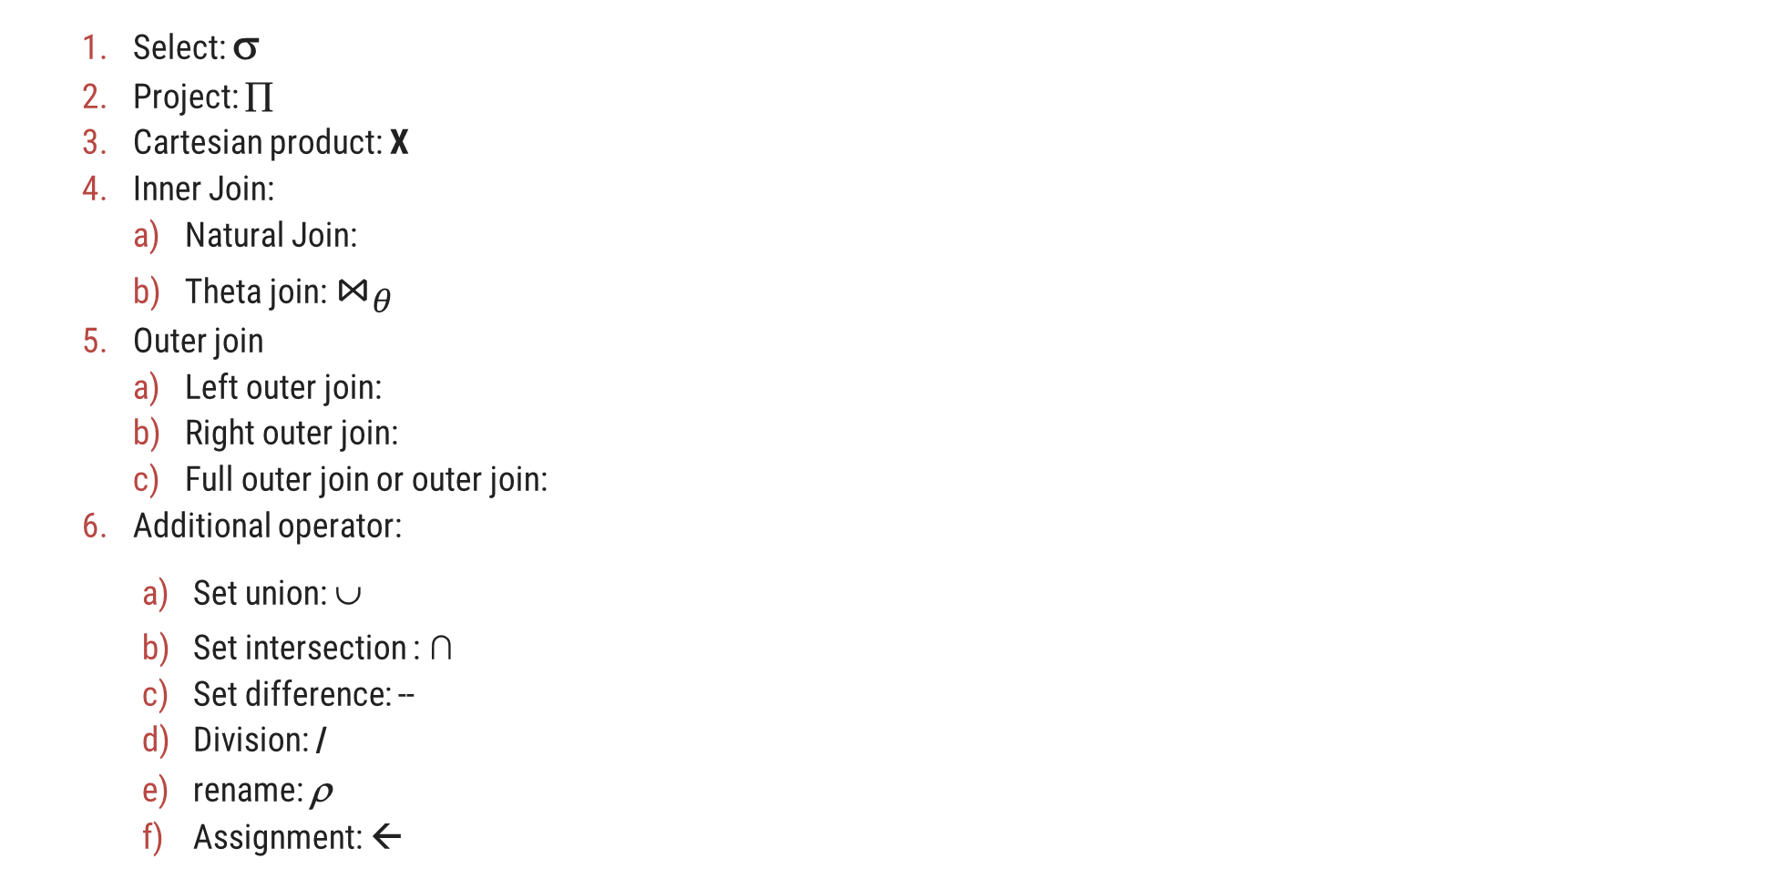
Operators
Select: σ
Project: ∏
Cartesian product: X
Inner Join:
Natural Join:
Theta join: $⋈_{θ}$
Outer join
Left outer join:
Right outer join:
Full outer join or outer join:
Additional operator:
Set union: ∪
Set intersection : ∩
Set difference: --
Division: /
rename: ρ
Assignment: ←

Slide 30
Relational Algebra Operations
Operator | Description
Selection | Display particular rows/records/tuples from a relation
Projection | Display particular columns from a relation
Cross Product | Multiply each tuples of both relations
Joins | Combine data or records from two or more tables Natural Join / Inner Join Outer Join 1. Left Outer Join 2. Right Outer Join 3. Full Outer Join
Set Operators | Combine the results of two queries into a single result. 1. Union 2. Intersection 3. Minus / Set-difference
Division | Divides one relation by another
Rename | Rename a column or a table

Slide 31
1. Select Operator
Symbol: σ (Sigma)
Notation: σ _{condition} (Relation)
Operation: Selects tuples from a relation that satisfy a given condition.
Operators: =, <>, <, >, <=, >=, Λ (AND), V (OR)
σ_{Branch=‘CE’} (Student)
Example
Display the detail of students belongs to “CE” Branch.
Answer
Student
Output
RollNo | Name | Branch | SPI
101 | Raju | CE | 8
102 | Mitesh | ME | 9
103 | Nilesh | CI | 9
104 | Meet | CE | 9
RollNo | Name | Branch | SPI
101 | Raju | CE | 8
104 | Meet | CE | 9

Slide 32
Selection Operator [σ _{condition} (Relation)]
Example
Display the detail of students belongs to “CE” Branch and having SPI more than 8.
Student
RollNo | Name | Branch | SPI
101 | Raju | CE | 8
102 | Mitesh | ME | 9
103 | Nilesh | CI | 9
104 | Meet | CE | 9
σ_{Branch=‘CE’ Λ SPI>8} (Student)
Answer
Output
RollNo | Name | Branch | SPI
104 | Meet | CE | 9

Slide 33
Selection Operator [σ _{condition} (Relation)]
Example
Display the detail of students belongs to either “CI” or “ME” Branch.
Student
RollNo | Name | Branch | SPI
101 | Raju | CE | 8
102 | Mitesh | ME | 9
103 | Nilesh | CI | 9
104 | Meet | CE | 9
σ_{Branch=‘CI’ V Branch=‘ME’} (Student)
Answer
Output
RollNo | Name | Branch | SPI
102 | Mitesh | ME | 9
103 | Nilesh | CI | 9

Slide 34
Selection Operator [σ _{condition} (Relation)]
Example
Display the detail of students whose SPI between 7 and 9.
Student
RollNo | Name | Branch | SPI
101 | Raju | CE | 8
102 | Mitesh | ME | 9
103 | Nilesh | CI | 9
104 | Meet | CE | 9
σ_{SPI>8 Λ SPI<9} (Student)
Answer
Output
RollNo | Name | Branch | SPI
101 | Raju | CE | 8

Slide 35
Exercise
Write down the relational algebra for the student table.
Display the detail of students whose RollNo is less than 104.
Display the detail of students having SPI more than 8.
Display the detail of students belongs to “CE” Branch having SPI less than 8.
Display the detail of students belongs to either “CE” or “ME” Branch.
Display the detail of students whose SPI between 6 and 9.
Student
RollNo | Name | Branch | SPI
101 | Raj | CE | 6
102 | Meet | ME | 8
103 | Harsh | EE | 7
104 | Punit | CE | 9
Write down the relational algebra for the employee table.
Display the detail of all employee.
Display the detail of employee whose Salary more than 10000.
Display the detail of employee belongs to “HR” Dept having Salary more than 20000.
Display the detail of employee belongs to either “HR” or “Admin” Dept.
Display the detail of employee whose Salary between 1000 and 25000 and belongs to “HR” Dept.
Employee
EmpID | Name | Dept | Salary
101 | Nilesh | Sales | 10000
102 | Mayur | HR | 25000
103 | Hardik | HR | 15000
104 | Ajay | Admin | 20000

Slide 36
2. Project Operator
Symbol: ∏ (Pi)
Notation: ∏ _{attribute set} (Relation)
Operation: Selects specified attributes of a relation.
It removes duplicate tuples (records) from the result.
∏ _{RollNo, Name, Branch} (Student)
Example
Display RollNo, Name and Branch of all students.
Answer
Student
Output
RollNo | Name | Branch | SPI
101 | Raju | CE | 8
102 | Mitesh | ME | 9
103 | Nilesh | CI | 9
104 | Meet | CE | 9
RollNo | Name | Branch
101 | Raju | CE
102 | Mitesh | ME
103 | Nilesh | CI
104 | Meet | CE

Slide 37
Exercise
Write down the relational algebra for the student table.
Display RollNo, Name and SPI of all students.
Display Name and SPI of all students.
Display the Name of all students.
Display the Name of all branches.
Student
RollNo | Name | Branch | SPI
101 | Raj | CE | 6
102 | Meet | ME | 8
103 | Harsh | EE | 7
104 | Punit | CE | 9
Write down the relational algebra for the employee table.
Display EmpID with Name of all employee.
Display Name and Salary of all employee.
Display the Name of all employee.
Display the Name of all departments.
Employee
EmpID | Name | Dept | Salary
101 | Nilesh | Sales | 10000
102 | Mayur | HR | 25000
103 | Hardik | HR | 15000
104 | Ajay | Admin | 20000

Slide 38
2.5 Combined Projection & Selection Operation
Example
Display RollNo, Name & Branch of “ME” Branch students.
Student
RollNo | Name | Branch | SPI
101 | Raju | CE | 8
102 | Mitesh | ME | 9
103 | Nilesh | CI | 9
104 | Meet | CE | 7
σ_{Branch=‘ME’} (Student)
∏ _{RollNo, Name, Branch} (σ_{Branch=‘ME’} (Student))
Step-1
Answer
Output-1
Output-2
RollNo | Name | Branch | SPI
102 | Mitesh | ME | 9
RollNo | Name | Branch
102 | Mitesh | ME

Slide 39
Combined Projection & Selection Operation
Example
Display Name, Branch and SPI of students whose SPI is more than 8.
Student
RollNo | Name | Branch | SPI
101 | Raju | CE | 8
102 | Mitesh | ME | 9
103 | Nilesh | CI | 9
104 | Meet | CE | 7
σ_{SPI>8} (Student)
∏ _{Name, Branch, SPI} (σ_{SPI>8} (Student))
Step-1
Answer
Output-1
Output-2
RollNo | Name | Branch | SPI
102 | Mitesh | ME | 9
103 | Nilesh | CI | 9
Name | Branch | SPI
Mitesh | ME | 9
Nilesh | CI | 9

Slide 40
Combined Projection & Selection Operation
Example
Display Name, Branch and SPI of students who belongs to “CE” Branch and SPI is more than 7.
Student
RollNo | Name | Branch | SPI
101 | Raju | CE | 8
102 | Mitesh | ME | 9
103 | Nilesh | CI | 9
104 | Meet | CE | 7
σ_{Branch=‘CE’ Λ SPI>7} (Student)
∏ _{Name, Branch, SPI} (σ_{Branch=‘CE’ Λ SPI>8} (Student))
Step-1
Answer
Output-1
Output-2
RollNo | Name | Branch | SPI
101 | Raju | CE | 8
Name | Branch | SPI
Raju | CE | 8

Slide 41
Combined Projection & Selection Operation
Example
Display Name of students along with their Branch who belong to either “ME” Branch or “CI” Branch.
Student
RollNo | Name | Branch | SPI
101 | Raju | CE | 8
102 | Mitesh | ME | 9
103 | Nilesh | CI | 9
104 | Meet | CE | 7
σ_{Branch=‘ME’ V Branch=‘CI’} (Student)
∏ _{Name, Branch} (σ_{Branch=‘ME’ V Branch=‘CI’} (Student))
Step-1
Answer
Output-1
Output-2
RollNo | Name | Branch | SPI
102 | Mitesh | ME | 9
103 | Nilesh | CI | 9
Name | Branch | SPI
Mitesh | ME | 9
Nilesh | CI | 9

Slide 42
Exercise
Write down the relational algebra for the student table.
Display Rollno, Name and SPI of all students belongs to “CE” Branch.
List the Name of students with their Branch whose SPI is more than 8 and belongs to “CE” Branch.
List the Name of students along with their Branch and SPI who belongs to either “CE” or “ME” Branch and having SPI more than 8.
Display the Name of students with their Branch name whose SPI between 7 and 9.
Student
RollNo | Name | Branch | SPI
101 | Raj | CE | 6
102 | Meet | ME | 8
103 | Harsh | EE | 7
104 | Punit | CE | 9
Write down the relational algebra for the employee table.
Display the Name of employee belong to “HR” Dept and having salary more than 20000.
Display the Name of all “Admin” and “HR” Dept’s employee.
List the Name of employee with their Salary who belongs to “HR” or “Admin” Dept having salary more than 15000.
Display the Name of employee along with their Dept name whose salary between 15000 and 30000.
Employee
EmpID | Name | Dept | Salary
101 | Nilesh | Sales | 10000
102 | Mayur | HR | 25000
103 | Hardik | HR | 15000
104 | Ajay | Admin | 20000

Slide 43
3. Cartesian Product / Cross Product
Symbol: X (Cross)
Notation: Relation-1 (R1) X Relation-2 (R2) OR Algebra-1 X Algebra-2
Operation: It will multiply each tuples of Relation-1 to each tuples of Relation-2.
Attributes of Resultant Relation = Attributes of R1 + Attributes of R2
Tuples of Resultant Relation = Tuples of R1 * Tuples of R2
Example
Perform Cross Product between Student and Result.
Answer
(Student) X (Result)
Student
Result
Output
RNo | Name | Branch
101 | Raju | CE
102 | Mitesh | ME
RNo | SPI
101 | 8
102 | 9
Student.RNo | Name | Branch | Result.RNo | SPI
101 | Raju | CE | 101 | 8
101 | Raju | CE | 102 | 9
102 | Mitesh | ME | 101 | 8
102 | Mitesh | ME | 102 | 9
If both relations have some attribute with the same name, it can be distinguished by combing relation-name.attribute-name.

Slide 44
Cartesian Product / Cross Product Example
Example
Perform Cross Product between Student and Result.
Consider only selected attributes
Student – RNo, Name and Branch
Result – RNo, SPI and BL
Student
Result
RNo | Name | Branch | Sem
101 | Raju | CE | 3
102 | Mitesh | ME | 5
RNo | SPI | BL | Rank
101 | 8 | 1 | 2
103 | 9 | 0 | 1
∏ _{RNo, Name, Branch} (Student) X ∏ _{RNo, SPI, BL} (Result)
Answer
Output
Student.RNo | Name | Branch | Result.RNo | SPI | BL
101 | Raju | CE | 101 | 8 | 1
101 | Raju | CE | 103 | 9 | 0
102 | Mitesh | ME | 101 | 8 | 1
102 | Mitesh | ME | 103 | 9 | 0

Slide 45
Cartesian Product / Cross Product Example
Example
Perform Cross Product between Student and Result.
Consider only selected tuples
Student – Branch=‘CE’ and Sem=3
Result – SPI>7 and BL<1
Student
Result
RNo | Name | Branch | Sem
101 | Raju | CE | 3
102 | Mitesh | ME | 5
103 | Om | CE | 3
104 | Dhara | CE | 5
RNo | SPI | BL | Rank
101 | 8 | 1 | 2
103 | 9 | 0 | 1
105 | 7 | 2 | 3
σ_{Branch=‘CE’ Λ Sem=3} (Student) X σ_{SPI>7 Λ BL<1} (Result)
Answer
Output
Student.RNo | Name | Branch | Sem | Result.RNo | SPI | BL | Rank
101 | Raju | CE | 3 | 103 | 9 | 0 | 1
103 | OM | CE | 3 | 103 | 9 | 0 | 1

Slide 46
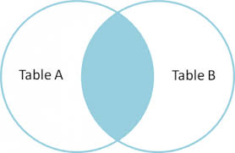
4. Natural Join / Inner Join
Symbol:
Notation: Relation-1 (R1) Relation-2 (R2) OR Algebra-1 Algebra-2
Operation: Natural join will retrieve consistent data from multiple relations.
It combines records from different relations that satisfy a given condition.
Steps performed in Natural Join
Steps | Description
Step – 1 | It performs Cartesian Product
Step – 2 | Then it deletes inconsistent tuples
Step – 3 | Then it removes an attribute from duplicate attributes

Slide 47
Let r and s be relations on schemas R and S respectively.
Then, r s is a relation on schema R ∪ S obtained as follows:
Consider each pair of tuples t_{r} from r and t_{s} from s.
If t_{r} and t_{s} have the same value on each of the attributes in R ∩ S, add a tuple t to the result, where
t has the same value as t_{r} on r
t has the same value as t_{s} on s
Example:
R = (A, B, C, D)
S = (E, B, D)
Result schema = (A, B, C, D, E)
r s is defined as:
∏_{r.A, r.B, r.C, r.D, s.E} (σ_{r.B = s.B} ∧ _{r.D = s.D} (r x s))

Slide 48
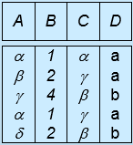
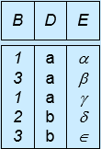
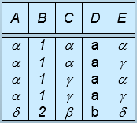
Relations r, s:
A
B
C
D
B
D
E





1
2
4
1
2





a
a
b
a
b
1
3
1
2
3
a
a
a
b
b





r
s
r s
A
B
C
D
E





1
1
1
1
2





a
a
a
a
b






Slide 49
Natural Join / Inner Join Example
Example
Perform Natural Join between Student and Result.
Answer
(Student) (Result)
Student
Result
Output
RNo | Name | Branch
101 | Raju | CE
102 | Mitesh | ME
RNo | SPI
101 | 8
103 | 9
RNo | Name | Branch | SPI
101 | Raju | CE | 8
To perform a Natural Join there must be one common attribute (column) between two relations.
Steps performed in Natural Join
Step:1 Perform Cross Product
Step:2 Removes inconsistent tuples
Student.RNo | Name | Branch | Result.RNo | SPI
101 | Raju | CE | 101 | 8
101 | Raju | CE | 103 | 9
102 | Mitesh | ME | 101 | 8
102 | Mitesh | ME | 103 | 9
Student.RNo | Name | Branch | Result.RNo | SPI
101 | Raju | CE | 101 | 8
Step:3 Removes an attribute from duplicate
RNo | Name | Branch | SPI
101 | Raju | CE | 8

Slide 50
Natural Join / Inner Join Example
Example
Perform Natural Join between Branch and Faculty.
Answer
(Branch) (Faculty)
Branch
Faculty
Output
BID | BName | HOD
1 | CE | Shah
2 | ME | Patel
FID | FName | BID
101 | Raj | 1
103 | Meet | 2
BID | Bname | HOD | FID | FName
1 | CE | Shah | 101 | Raj
2 | ME | Patel | 102 | Meet
To perform a Natural Join there must be one common attribute (column) between two relations.

Slide 51
Write down relational algebra for the following tables/relations
Relations
Student (Rno, Sname, Address, City, Mobile)
Department (Did, Dname)
Academic (Rno, Did, SPI, CPI, Backlog)
Guide (Rno, PName, Fid)
Faculty (Fid, Fname, Subject, Did, Salary)
Example
List the name of students with their department name and SPI of all student belong to “CE” department.
∏ _{Sname, Dname, SPI}
(σ_{Dname=‘CE’} (Student (Department Academic)))
Answer
Example
Display the name of students with their project name whose guide is “A. J. Shah”.
∏ _{Sname, Pname}
(σ_{Fname=‘A.J.Shah’} (Student (Guide Faculty)))
Answer

Slide 52
Exercise: Write down relational algebra for the following tables/relations
Relations
Student (Rno, Sname, Address, City, Mobile)
Department (Did, Dname)
Academic (Rno, Did, SPI, CPI, Backlog)
Guide (Rno, PName, Fid)
Faculty (Fid, Fname, Subject, Did, Salary)
List the name of students with their department name having backlog 0.
List the name of faculties with their department name and salary having salary more than 25000 and belongs to “CE” department.
List the name of all faculties of “CE” and “ME” department whose salary is more than 50000.
Display the students name with their project name of all “CE” department’s students whose guide is “Z.Z. Patel”.
Display the name of faculties with their department name who belongs to “CE” department and tough “CPU” subject having salary more than 25000.
List the name of students with their department name doing project “Hackathon” under guide “I. I. Shah”.

Slide 53
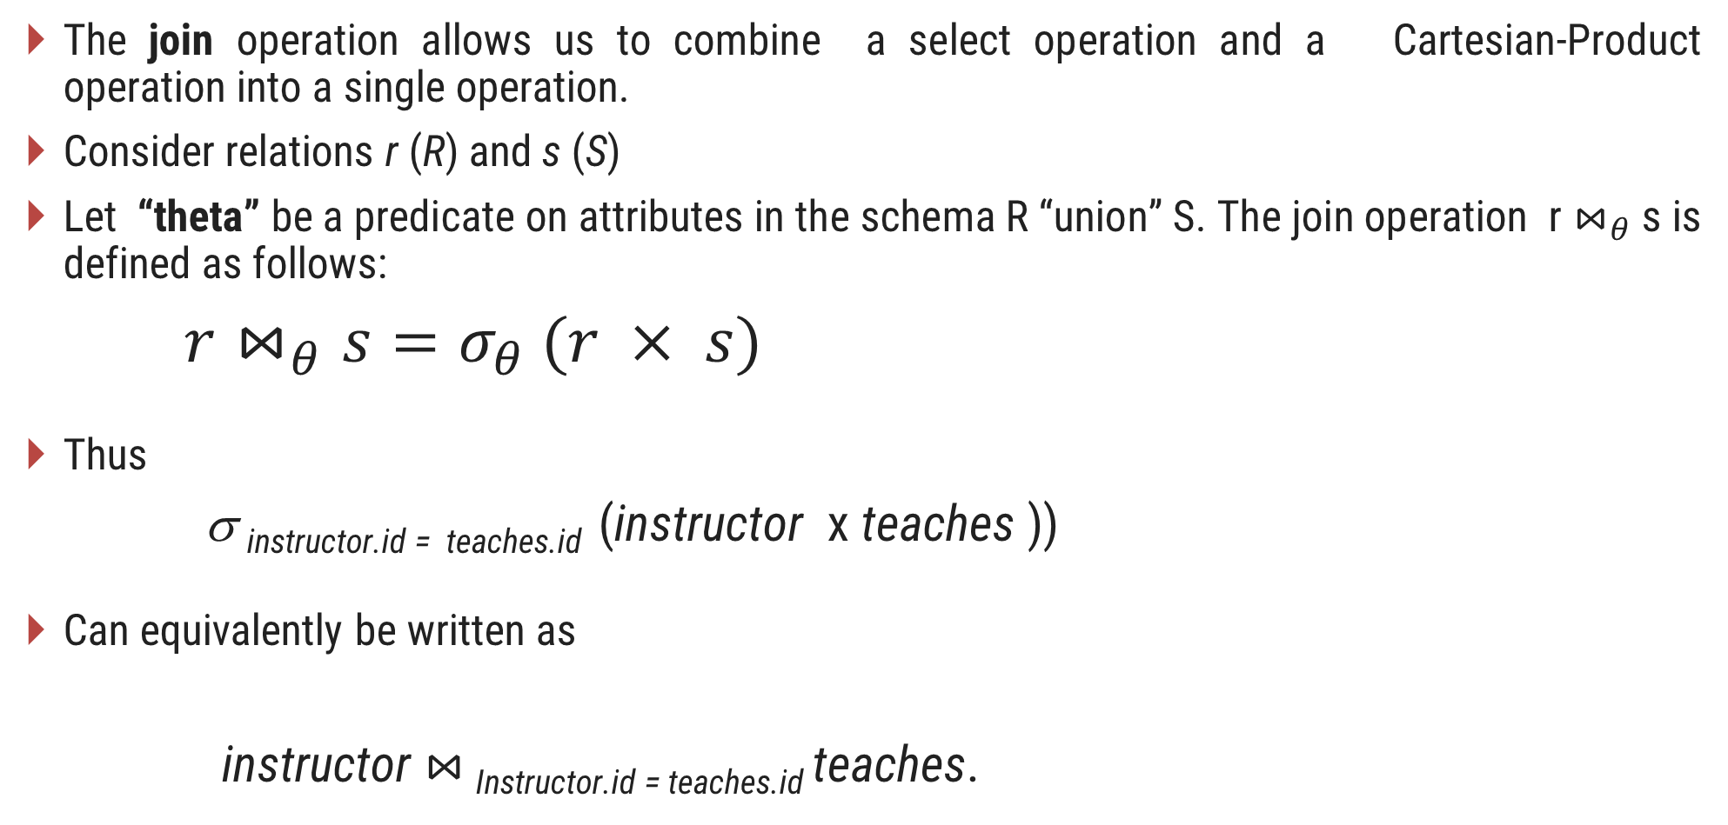
4(a)Theta Join Operation
The join operation allows us to combine a select operation and a Cartesian-Product operation into a single operation.
Consider relations r (R) and s (S)
Let “theta” be a predicate on attributes in the schema R “union” S. The join operation r $⋈_{θ}$ s is defined as follows:
$r⋈_{θ}s=σ_{θ} (r × s)$
Thus
σ _{instructor.id = teaches.id} (instructor x teaches ))
Can equivalently be written as
instructor $⋈_{ }$_{Instructor.id = teaches.id} teaches.

Slide 54
5. Outer Join
In natural join some records are missing, if we want that missing records than we have to use outer join.
Three types of Outer Join
Sr. | Outer Join | Symbol
1 | Left Outer Join
2 | Right Outer Join
3 | Full Outer Join
To perform a Outer Join there must be one common attribute (column) between two relations.

Slide 55
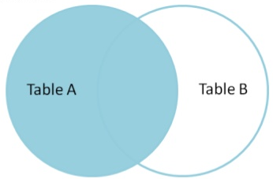
5(a) Left Outer Join
Symbol:
Notation: Relation-1 (R1) Relation-2 (R2) OR Algebra-1 Algebra-2
Operation:
Display all the tuples of the left relation even though there is no matching tuple in the right relation.
For such kind of tuples having no matching, the attributes of right relation will be padded with NULL in resultant relation.
Example
Perform Left Outer Join between Student and Result.
Answer
(Student) (Result)
Student
Result
Output
RollNo | Name | Branch
101 | Raju | CE
102 | Meet | ME
RollNo | SPI
101 | 8
103 | 9
RollNo | Name | Branch | SPI
101 | Raju | CE | 8
102 | Meet | ME | NULL
Exercise
What is the output of (Result) (Student).

Slide 56
Left Outer Join Example
Example
Perform Left Outer Join between Student and Result. (Display RollNo, Name and SPI)
Student
Result
RollNo | Name | Branch
101 | Raju | CE
102 | Meet | ME
RollNo | SPI | BL
101 | 8 | 1
103 | 9 | 0
∏ _{RollNo, Name, SPI}
((Student) (Result))
Answer
Output
RollNo | Name | SPI
101 | Raju | 8
102 | Meet | NULL

Slide 57
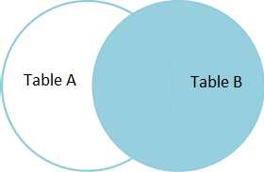
5(b) Right Outer Join
Symbol:
Notation: Relation-1 (R1) Relation-2 (R2) OR Algebra-1 Algebra-2
Operation:
Display all the tuples of right relation even through there is no matching tuple in the left relation.
For such kind of tuples having no matching, the attributes of left relation will be padded with NULL in resultant relation.
Example
Perform Right Outer Join between Student and Result.
Answer
(Student) (Result)
Student
Result
Output
RollNo | Name | Branch
101 | Raju | CE
102 | Meet | ME
RollNo | SPI
101 | 8
103 | 9
RollNo | Name | Branch | SPI
101 | Raju | CE | 8
103 | NULL | NULL | 9
Exercise
What is the output of (Result) (Student).

Slide 58
Right Outer Join Example
Example
Perform Right Outer Join between Student and Result. (Display RollNo, Name and SPI)
Student
Result
RollNo | Name | Branch
101 | Raju | CE
102 | Meet | ME
RollNo | SPI | BL
101 | 8 | 1
103 | 9 | 0
∏ _{RollNo, Name, SPI}
((Student) (Result))
Answer
Output
RollNo | Name | SPI
101 | Raju | 8
103 | NULL | 9

Slide 59
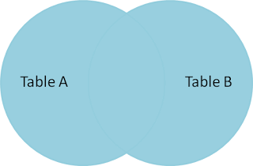
5(c) Full Outer Join
Symbol:
Notation: Relation-1 (R1) Relation-2 (R2) OR Algebra-1 Algebra-2
Operation:
Display all the tuples of both of the relations. It also pads null values whenever required. (Left outer join + Right outer join)
For such kind of tuples having no matching, it will be padded with NULL in resultant relation.
Example
Perform Full Outer Join between Student and Result.
Answer
(Student) (Result)
Student
Result
Output
RollNo | Name | Branch
101 | Raju | CE
102 | Meet | ME
RollNo | SPI
101 | 8
103 | 9
RollNo | Name | Branch | SPI
101 | Raju | CE | 8
102 | Meet | ME | NULL
103 | NULL | NULL | 9
Exercise
What is the output of (Result) (Student).

Slide 60
Full Outer Join Example
Example
Perform Full Outer Join between Student and Result. (Display RollNo, Name and SPI)
Student
Result
RollNo | Name | Branch
101 | Raju | CE
102 | Meet | ME
RollNo | SPI | BL
101 | 8 | 1
103 | 9 | 0
∏ _{RollNo, Name, SPI}
((Student) (Result))
Answer
Output
RollNo | Name | SPI
101 | Raju | 8
102 | Meet | NULL
103 | NULL | 9

Slide 61
6. Set Operators
Set operators combine the results of two or more queries into a single result.
Three types of Set Operators
Sr. | Set Operator | Symbol
1 | Union | U
2 | Intersect / Intersection | ∩
3 | Minus / Set difference | −
Conditions
Set operators will take two or more queries as input, which must be union-compatible.
Both relation should have same (equal) number of columns
Corresponding attributes should have the same data type or domain

Slide 62

Conditions to perform Set Operators
Conditions-1
Both relation should have same (equal) number of columns.
Student
Faculty
Student
Faculty
RNo | Name | Dept | SPI
101 | Raj | CE | 8
102 | Meet | ME | 9
103 | Jay | CE | 9
FId | Name | Dept
101 | Patel | CE
102 | Shah | ME
103 | Dave | ME
RNo | Name | Dept | SPI
101 | Raj | CE | 8
102 | Meet | ME | 9
103 | Jay | CE | 9
FId | Name | Dept | Exp
101 | Patel | CE | 5
102 | Shah | ME | 3
103 | Dave | ME | 4
Conditions-2
Corresponding attributes should have the same data type.
Student
Faculty
Student
Faculty
RNo | Name | Dept | SPI
101 | Raj | CE | 8
102 | Meet | ME | 9
103 | Jay | CE | 9
FId | Name | Dept | Sub
101 | Patel | CE | DS
102 | Shah | ME | DBMS
103 | Dave | ME | DF
RNo | Name | Dept | SPI
101 | Raj | CE | 8
102 | Meet | ME | 9
103 | Jay | CE | 9
FId | Name | Dept | Exp
101 | Patel | CE | 5
102 | Shah | ME | 3
103 | Dave | ME | 4

Slide 63
Set Operators [Exercise]
Exercise
Check whether following tables are compatible or not:
A: (First_name(char), Last_name(char), Date_of_Birth(date))
B: (FName(char), LName(char), PhoneNumber(number))
(Not compatible) Both tables have 3 attributes but third attributes datatype is different.
A: (First_name(char), Last_name(char), Date_of_Birth(date))
B: (FName(char), LName(char), DOB(date))
(Compatible) Both tables have 3 attributes and of same data type.
Person (PersonID, Name, Address, Hobby)
Professor (ProfessorID, Name, OfficeAddress, Salary)
(Not compatible) Both tables have 4 attributes but forth attributes datatype is different.
(Compatible) Both tables have 2 attributes and of same data type.
∏ _{Name, Address} (Person)
&
∏ _{Name, OfficeAddress} (Professor)

Slide 64
6(a) Union Operator
Symbol: U
Notation: Relation-1 (R1) U Relation-2 (R2) OR Algebra-1 U Algebra-2
Operation:
It displays all the tuples/records belonging to the first relation (left relation) or the second relation (right relation) or both.
It also eliminates duplicate tuples (tuples present in both relations appear once).
Example
Perform Union between Customer and Employee.
Answer
(Customer) U (Employee)
Customer
Employee
Output
Name
Raju
Suresh
Meet
Name
Meet
Suresh
Manoj
Name
Manoj
Meet
Raju
Suresh
Exercise
Is there any difference in the output if we swap the tables in Union operator. (Employee) U (Customer).

Slide 65
6(b) Intersect/ Intersection Operator
Symbol: ∩
Notation: Relation-1 (R1) ∩ Relation-2 (R2) OR Algebra-1 ∩ Algebra-2
Operation:
It displays all the tuples/records belonging to both relations. OR
It displays all the tuples/records which are common from both relations.
Example
Perform Intersection between Customer and Employee.
Answer
(Customer) ∩ (Employee)
Customer
Employee
Output
Name
Raju
Suresh
Meet
Name
Meet
Suresh
Manoj
Name
Meet
Suresh
Exercise
Is there any difference in the output if we swap the tables in Intersection. (Employee) ∩ (Customer).

Slide 66
6(c) Minus/ Set difference Operator
Symbol: −
Notation: Relation-1 (R1) − Relation-2 (R2) OR Algebra-1 − Algebra-2
Operation:
It displays all the tuples/records belonging to the first relation (left relation) but not in the second relation (right relation).
Example
Perform Set difference between Customer and Employee.
Answer
(Customer) − (Employee)
Customer
Employee
Output
Name
Raju
Suresh
Meet
Name
Meet
Suresh
Manoj
Name
Raju
Exercise
Is there any difference in the output if we swap the tables in Set difference. (Employee) − (Customer).

Slide 67
Union Operators Example
Example
Display Name of person who are either employee or customer.
Customer
Employee
ID | Name | Balance
1 | Raju | 10000
2 | Suresh | 20000
ID | Name | Dept | Salary
2 | Suresh | CE | 8000
3 | Manoj | ME | 9000
∏ _{Name} (Customer) U ∏ _{Name} (Employee)
Answer
Output
Name
Manoj
Raju
Suresh

Slide 68
Intersect/ Intersection Operators Example
Example
Display Name of person who are employee as well as customer.
Customer
Employee
ID | Name | Balance
1 | Raju | 10000
2 | Suresh | 20000
ID | Name | Dept | Salary
2 | Suresh | CE | 8000
3 | Manoj | ME | 9000
∏ _{Name} (Customer) ∩ ∏ _{Name} (Employee)
Answer
Output
Name
Suresh

Slide 69
Minus/ Set difference Operators Example
Example
Display Name of person who are employee but not customer.
Customer
Employee
ID | Name | Balance
1 | Raju | 10000
2 | Suresh | 20000
ID | Name | Dept | Salary
2 | Suresh | CE | 8000
3 | Manoj | ME | 9000
∏ _{Name} (Employee) − ∏ _{Name} (Customer)
Answer
Output
Name
Manoj

Slide 70
Minus/ Set difference Operators Example
Example
Display Name of person who are customer but not employee.
Customer
Employee
ID | Name | Balance
1 | Raju | 10000
2 | Suresh | 20000
ID | Name | Dept | Salary
2 | Suresh | CE | 8000
3 | Manoj | ME | 9000
∏ _{Name} (Customer) − ∏ _{Name} (Employee)
Answer
Output
Name
Raju

Slide 71
Set Operators [Exercise]
Exercise
What is the output of following relational algebra for the below mentioned tables:
Customer
Employee
ID | Name | Balance
1 | Raju | 10000
2 | Suresh | 20000
ID | Name | Dept | Salary
2 | Suresh | CE | 8000
3 | Manoj | ME | 9000
∏ _{ID, Name} (Customer) U ∏ _{ID, Name} (Employee)
Algebra-1
∏ _{ID, Name, Balance} (Customer) U ∏ _{ID, Name, Salary} (Employee)
Algebra-2
∏ _{ID, Name} (Customer) ∩ ∏ _{ID, Name} (Employee)
Algebra-3
∏ _{ID, Name, Balance} (Customer) ∩ ∏ _{ID, Name, Salary} (Employee)
Algebra-4

Slide 72
Set Operators [Exercise]
Exercise
What is the output of following relational algebra for the below mentioned tables:
Customer
Employee
ID | Name | Balance
1 | Raju | 10000
2 | Suresh | 20000
ID | Name | Dept | Salary
2 | Suresh | CE | 8000
3 | Manoj | ME | 9000
∏ _{ID, Name} (Customer) − ∏ _{ID, Name} (Employee)
Algebra-1
∏ _{ID, Name, Balance} (Customer) − ∏ _{ID, Name, Salary} (Employee)
Algebra-2
∏ _{ID, Name} (Employee) − ∏ _{ID, Name} (Customer)
Algebra-3
∏ _{ID, Name, salary}(Employee) − ∏ _{ID, Name, balance} (Customer)
Algebra-4

Slide 73
6(d) Division Operator
Symbol: ÷ (Division)
Notation: Relation1 (R1) ÷ Relation2 (R2) OR Algebra1 ÷ Algebra2
Condition:
Attributes of relation2/algebra2 must be a proper subset of attributes of relation1/algebra1.
Operation:
The output of the division operator will have attributes =
All attributes of relation1 – All attributes of relation2
The output of the division operator will have tuples =
Tuples in relation1, which are associated with the all tuples of relation2.

Slide 74
Division Operator Example
Example
Perform Division operation between Student and Subject.
Answer
(Student) ÷ (Subject)
Student
Subject
Output
Name | Subject
Raj | DBMS
Raj | DS
Meet | DS
Meet | DF
Rohit | DBMS
Rohit | DS
Rohit | DF
Suresh | DBMS
Suresh | DF
Suresh | DS
Subject
DBMS
DS
DF
Name
Rohit
Suresh

Slide 75
Division Operator Example
A
B1
B2
B3
B4
Sno | PNo
S1 | P1
S1 | P2
S1 | P3
S1 | P4
S2 | P1
S2 | P2
S3 | P2
S4 | P2
S4 | P4
S5 | P4
PNo
P2
PNo
P2
P4
PNo
P1
P2
P4
PNo
P2
P5
Algebra
(A) ÷ (B1)
Algebra
(A) ÷ (B2)
Algebra
(A) ÷ (B3)
Algebra
(A) ÷ (B4)
Output
Output
Output
Output
SNo
S1
S2
S3
S4
SNo
S1
S4
SNo
S1
SNo

Slide 76
Division Operator Example
Example
List the name of students doing a project in all technologies.
Student
Project
RNo | Name | Technology
101 | Raj | .NET
101 | Raj | PHP
102 | Meet | .NET
102 | Meet | PHP
102 | Meet | iPhone
102 | Meet | Android
103 | Rohit | Android
104 | Suresh | .NET
104 | Suresh | iPhone
104 | Suresh | Android
TID | Technology
1 | .NET
2 | PHP
3 | Android
4 | iPhone
Answer
∏ _{Name, Technology} (Student) ÷ ∏ _{Technology} (Project)
Output
Name
Meet

Slide 77
Rename Operator
Symbol: ρ (Rho)
Notation: ρ_{A (X1,X2….Xn)} (Relation)
Operation:
The rename operation is used to rename the output relation.
The result of rename operator are also relations with new name.
The original relation name can not be changed when we perform rename operation on any relation.
How to use:
ρ _{x} (E)
Returns a relation E under a new name X.
ρ _{A1, A2. …,An} (E)
Returns a relation E with the attributes renamed to A1, A2, …., An.
ρ _{x(A1, A2. …,An)} (E)
Returns a relation E under a new name X with the attributes renamed to A1, A2, …., An.

Slide 78
Rename Operator Example
Example
Rename table
Example
Rename attributes
Student
Student
RNo | Name | CPI
101 | Raj | 8
102 | Meet | 9
103 | Jay | 7
Rno | Name | CPI
101 | Raj | 8
102 | Meet | 9
103 | Jay | 7
Algebra
ρ_{Person} (Student)
Algebra
ρ_{(RollNo, StudentName, SPI)} (Student)
Person
Student
RNo | Name | CPI
101 | Raj | 8
102 | Meet | 9
103 | Jay | 7
RollNo | StudentName | SPI
101 | Raj | 8
102 | Meet | 9
103 | Jay | 7

Slide 79
Rename Operator Example
Example
Rename table and attributes both
Example
Rename particular attributes
Student
Student
Rno | Name | CPI
101 | Raj | 8
102 | Meet | 9
103 | Jay | 7
Rno | Name | CPI
101 | Raj | 8
102 | Meet | 9
103 | Jay | 7
Algebra
ρ_{Person (RollNo, StudentName)} (∏ _{RNo, Name} (Student))
Algebra
ρ_{StudentName / Name} (Student)
Person
Student
RollNo | StudentName
101 | Raj
102 | Meet
103 | Jay
Rno | StudentName | CPI
101 | Raj | 8
102 | Meet | 9
103 | Jay | 7

Slide 80
Rename Operator Example
Example
Find out maximum CPI from student table.
Step-1
ρ_{A} (Student) X ρ_{B} (Student)
Student
Output-1
Rno | Name | CPI
101 | Raj | 8
102 | Meet | 9
103 | Jay | 7
A.Rno | A.Name | A.CPI | B.Rno | B.Name | B.CPI
101 | Raj | 8 | 101 | Raj | 8
101 | Raj | 8 | 102 | Meet | 9
101 | Raj | 8 | 103 | Jay | 7
102 | Meet | 9 | 101 | Raj | 8
102 | Meet | 9 | 102 | Meet | 9
102 | Meet | 9 | 103 | Jay | 7
103 | Jay | 7 | 101 | Raj | 8
103 | Jay | 7 | 102 | Meet | 9
103 | Jay | 7 | 103 | Jay | 7
σ_{A.CPI<B.CPI} (ρ_{A} (Student) X ρ_{B} (Student))
Step-2
Output-2
A.Rno | A.Name | A.CPI | B.Rno | B.Name | B.CPI
101 | Raj | 8 | 102 | Meet | 9
103 | Jay | 7 | 101 | Raj | 8
103 | Jay | 7 | 102 | Meet | 9

Slide 81
Rename Operator Example
Example
Find out maximum CPI from student table.
Student
∏ _{A.CPI} (σ_{A.CPI<B.CPI} (ρ_{A} (Student) X ρ_{B} (Student)))
Step-3
Rno | Name | CPI
101 | Raj | 8
102 | Meet | 9
103 | Jay | 7
Output-3
A.CPI
8
7
σ_{A.CPI<B.CPI} (ρ_{A} (Student) X ρ_{B} (Student))
Step-2
Output-2
A.Rno | A.Name | A.CPI | B.Rno | B.Name | B.CPI
101 | Raj | 8 | 102 | Meet | 9
103 | Jay | 7 | 101 | Raj | 8
103 | Jay | 7 | 102 | Meet | 9

Slide 82
Rename Operator Example
Example
Find out maximum CPI from student table.
Student
∏ _{A.CPI} (σ_{A.CPI<B.CPI} (ρ_{A} (Student) X ρ_{B} (Student)))
Step-3
Rno | Name | CPI
101 | Raj | 8
102 | Meet | 9
103 | Jay | 7
Output-3
A.CPI
8
7
∏ _{CPI} (Student) − ∏ _{A.CPI} (σ_{A.CPI<B.CPI} (ρ_{A} (Student) X ρ_{B} (Student)))
Step-4
Student
Output-3
Output
CPI
8
9
7
A.CPI
8
7
CPI
9
−
=

Slide 83
Aggregate Functions
Symbol: g or G
Notation: g function-name(column), function-name(column), …, function-name(column) (Relation)
Operation:
It takes a more than one value as input and returns a single value as output (result).
Aggregate functions are:
Sum (It returns the sum (addition) of the values of a column.)
Max (It returns the maximum value for a column.)
Min (It returns the minimum value for a column.)
Avg (It returns the average of the values for a column.)
Count (It returns total number of values in a given column.)

Slide 84
Aggregate Functions Example
Student
Example
Find out sum of CPI of all students.
Output
Rno | Name | Branch | Semester | CPI
101 | Ramesh | CE | 3 | 9
102 | Mahesh | EC | 3 | 8
103 | Suresh | ME | 4 | 7
104 | Amit | EE | 4 | 8
105 | Anita | CE | 4 | 8
106 | Reeta | ME | 3 | 7
107 | Rohit | EE | 4 | 9
108 | Chetan | CE | 3 | 8
109 | Rakesh | CE | 4 | 9
g _{sum(CPI)} (Student)
sum
73
Answer
Example
Find out maximum & minimum CPI.
Output
g _{max(CPI), min(CPI)} (Student)
max | min
9 | 7
Answer
Example
Count the number of students.
Output
g _{count(Rno)} (Student)
count
9
Answer
Example
Find out average of CPI of all students.
Output
g _{avg(CPI)} (Student)
avg
8.11
Answer

Slide 85
Assignment Operator
It is convenient at times to write a relational-algebra expression by assigning parts of it to temporary relation variables.
The assignment operation is denoted by ← and works like assignment in a programming language.
Example: Find all instructor in the “Physics” and Music department.
Physics ← σ _{dept_name=“Physics”} (instructor)
Music ← σ _{dept_name=“Music”} (instructor)
Physics ∪ Music
With the assignment operation, a query can be written as a sequential program consisting of a series of assignments followed by an expression whose value is displayed as the result of the query.

Slide 86
Equivalent Queries
There is more than one way to write a query in relational algebra.
Example: Find information about courses taught by instructors in the Physics department with salary greater than 90,000
Query 1
σ _{dept_name=“Physics”} ∧ _{salary > 90,000} (instructor)
Query 2
σ _{dept_name=“Physics”} (σ _{salary > 90.000} (instructor))
The two queries are not identical; they are, however, equivalent -- they give the same result on any database.

Slide 87
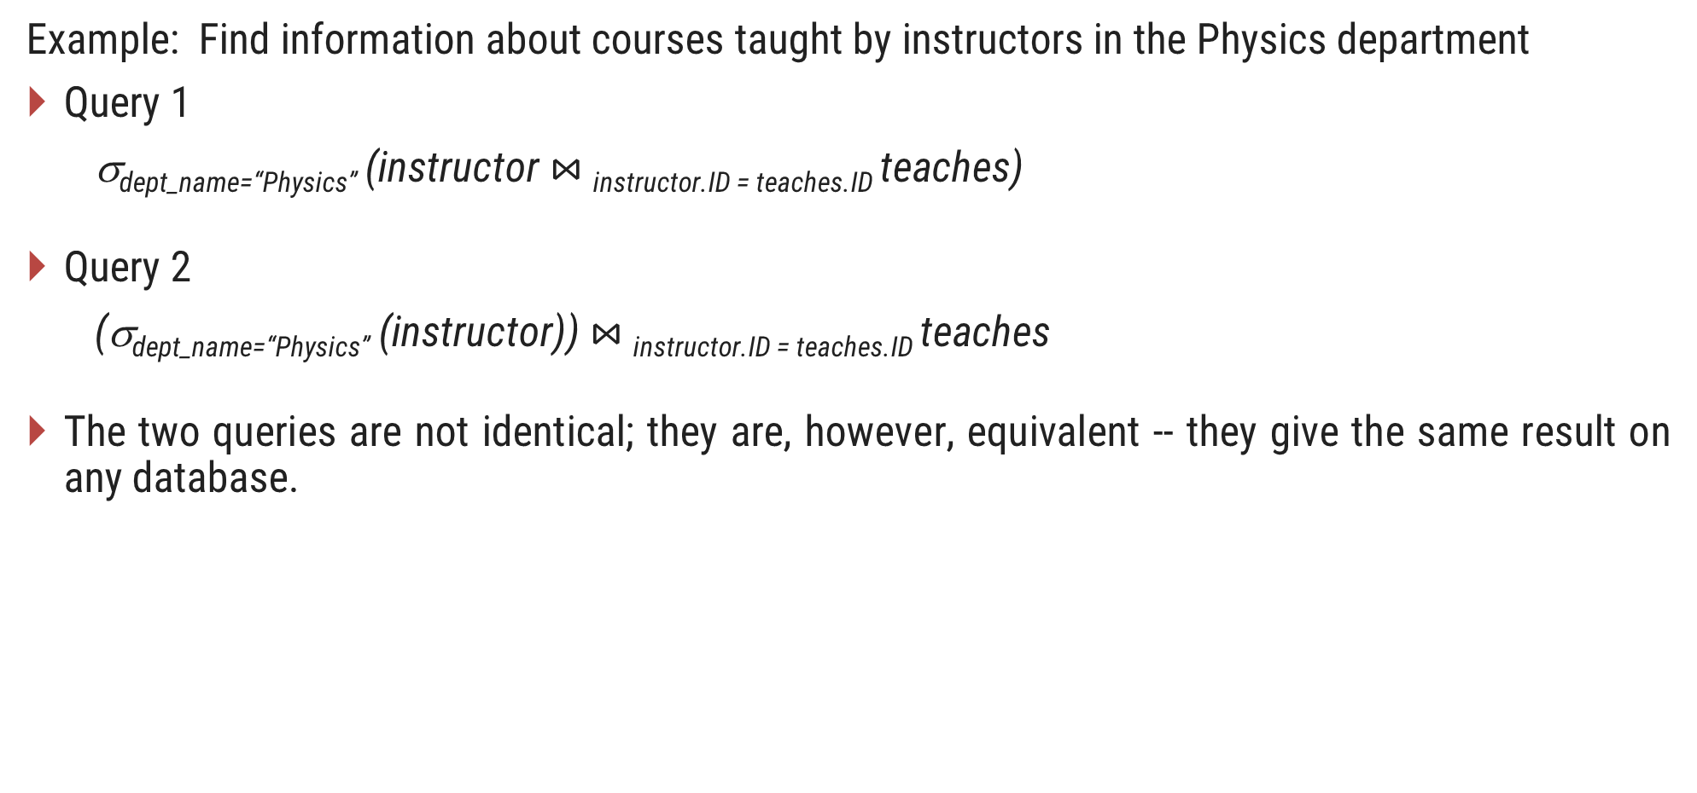
Example: Find information about courses taught by instructors in the Physics department
Query 1
σ_{dept_name=“Physics”} (instructor $⋈_{ }$_{instructor.ID = teaches.ID} teaches)
Query 2
(σ_{dept_name=“Physics”} (instructor)) $⋈_{ }$_{instructor.ID = teaches.ID} teaches
The two queries are not identical; they are, however, equivalent -- they give the same result on any database.

Slide 88
Exercise
1. Consider the relations r₁(P, Q, R) and r₂(R, S, T) with primary keys P and R respectively. The relation r₁ contains 2000 tuples and r₂ contains 2500 tuples. The maximum size of the join r₁⋈ r₂ is.
(A) 2000 (B) 2500 (C) 4500 (D) 5000
2. Consider a database table T containing two columns X and Y each of type integer. After the creation of the table, one record (X=1, Y=1) is inserted in the table.
Let MX and MY denote the respective maximum values of X and Y among all records in the table at any point in time. Using MX and MY, new records are inserted in the table 128 times with X and Y values being MX+1, 2*MY+1 respectively. It may be noted that each time after the insertion, values of MX and MY change. What will be the output of the following SQL query after the steps mentioned above are carried out?
SELECT Y FROM T WHERE X=7;

Slide 89
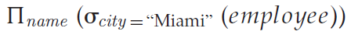
Exercise 1
employee (name, street, city)
works (name, cname, salary)
company (cname, city)
Find the names of all employees who live in city “Miami”.
Find the names of all employees whose salary is greater than $100,000.
Find the names of all employees who live in “Miami” and whose salary is greater than $100,000.

Slide 90
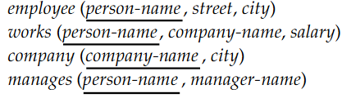
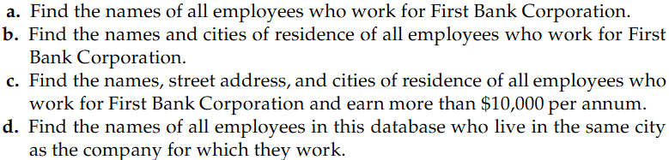
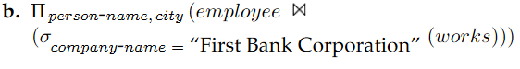
Exercise 2

Slide 91
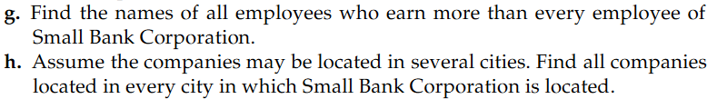
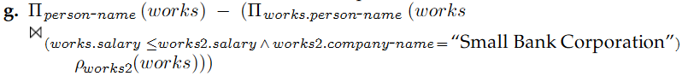
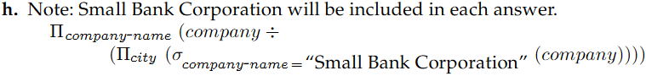

Slide 92
Example 3
branch (branch-name, branch-city, assets)
customer (customer-name, customer-street, customer-only)
account (account-number, branch-name, balance)
loan (loan-number, branch-name, amount)
depositor (customer-name, account-number)
borrower (customer-name, loan-number)
Find the names of all branches located in “Chicago”.
Find the names of all borrowers who have a loan in branch “Downtown”.

Slide 93
branch (branch-name, branch-city, assets)
customer (customer-name, customer-street, customer-only)
account (account-number, branch-name, balance)
loan (loan-number, branch-name, amount)
depositor (customer-name, account-number)
borrower (customer-name, loan-number)
_{amount > 1200} (loan)
Find all loans of over $1200
Find the loan number for each loan of an amount greater than $1200
_{loan-number} (_{amount} _{> 1200} (loan))
Find the names of all customers who have a loan, an account, or both, from the bank
_{customer-name} (borrower)  _{customer-name} (depositor)

Slide 94
branch (branch-name, branch-city, assets)
customer (customer-name, customer-street, customer-only)
account (account-number, branch-name, balance)
loan (loan-number, branch-name, amount)
depositor (customer-name, account-number)
borrower (customer-name, loan-number)
Find the names of all customers who have a loan and an account at bank.
_{customer-name} (borrower)  _{customer-name} (depositor)
Find the names of all customers who have a loan at the Perryridge branch.
_{customer-name} (_{branch-name=“Perryridge”} (borrower.loan-number = loan.loan-number(borrower x loan)))

Slide 95
Find the largest account balance( Rename account relation as d )
_{balance}(account) - _{account.balance} (_{account.balance < d.balance} (account x ρ_{d} (account)))
1 | A | 500
2 | B | 300
3 | C | 700
1 | A | 500
2 | B | 300
3 | C | 700
account
d(account)
1 | A | 500 | 1 | A | 500
1 | A | 500 | 2 | B | 300
1 | A | 500 | 3 | C | 700
2 | B | 300 | 1 | A | 500
2 | B | 300 | 2 | B | 300
2 | B | 300 | 3 | C | 700
3 | C | 700 | 1 | A | 500
3 | C | 700 | 2 | B | 300
3 | C | 700 | 3 | C | 700
1 | A | 500 | 1 | A | 500
1 | A | 500 | 2 | B | 300
1 | A | 500 | 3 | C | 700
2 | B | 300 | 1 | A | 500
2 | B | 300 | 2 | B | 300
2 | B | 300 | 3 | C | 700
3 | C | 700 | 1 | A | 500
3 | C | 700 | 2 | B | 300
3 | C | 700 | 3 | C | 700
account x d

Slide 96
Example 4
Suppliers(sid, sname, address)
Parts(pid, pname, color)
Catalog(sid, pid, cost)

Slide 97
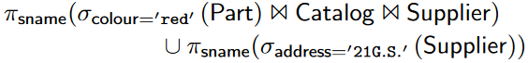
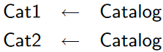
Suppliers(sid, sname, address)
Parts(pid, pname, color)
Catalog(sid, pid, cost)

Slide 98
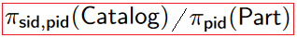
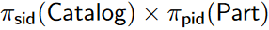
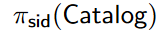
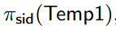
Suppliers(sid, sname, address)
Parts(pid, pname, color)
Catalog(sid, pid, cost)

Slide 99
Relational Algebra [Exercise-1]
Write down relational algebras for the following table:
Employee (person-name, street, city)
Works (person-name, company-name, salary)
Company (company-name, city)
Managers (person-name, manager-name)
Find the names of all employees who work for “TCS”.
Find the names and cities of residence of all employees who work for “Infosys”.
Find the names, street and city of residence of all employees who work for “ITC” and earn more than $10,000 per annum.
Find the names of all employees in this database who live in the same city as the company for which they work.
Find the names of all employees working in “TCS” who earn more than 25000 and less than 40000.
Find the name of employee whose manager is “Ajay Patel” and salary is more than 50000.
Display the name of employee with street, city, company name, salary and manager name staying in “Rajkot” and working in “Ahmedabad”.
Find maximum, minimum and average salary of all employee.
Find out the total number of employee.

Slide 100
Relational Algebra [Exercise-2]
Reserves(sid, bid, day)
Sailors(sid, sname, rating, age)
Boats(bid, bname, color)
Find names of sailors who have reserved boat #103
Find names of sailors who have reserved a red boat
Find the colors of boats reserved by Lubber
Find the names of sailors who have reserved at least one boat
Find the names of sailors who have reserved a red or a green boat
Find the names of sailors who have reserved a red and a green boat
Find the sids of sailors with age over 20 who have not reserved a red boat

Slide 101
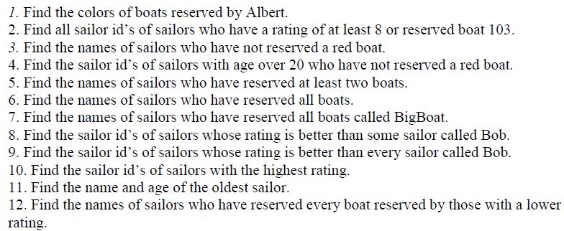
Relational Algebra [Exercise-3]
Reserves(sid, bid, day)
Sailors(sid, sname, rating, age)
Boats(bid, bname, color)

